Slide 1
Capstone project

Slide 2
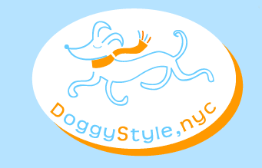
The problem
What is the best location to expand?
The NYC Store Doggy Style NYC, would like to open a store in Toronto, Canada. .
For 2018, it estimated that $72.13 billion was spent on pets in the U.S.
Expansion into Canada is a massive business opportunity, with Toronto being the largest market in Canada.
By using data, it is hoped that a more informed approach to neighbourhood selection could be utilized.

Slide 3
The Data
Statistical data on distribution of pets in the city as well as existing potentially competitive retail stores and services are critical factors in determine the suitability of a location for a pet store. Data on distribution of pets and potentially competitive stores is needed.
The following data sets will be utilized:
The City of Toronto’s Open Data Catalogue for data on pets in Toronto by area code
Wikipedia for a list of Toronto's Area codes by Borough and Neighbourhood and area code
Foursquare API to get the store and services in a given Borough and Neighbourhood of Toronto and the store in NYC
Long and Lat corrdinates by area code provided by https://cocl.us/Geospatial_data

Slide 4
Methodology
Import and clean the data
understand needs, pains and dissatisfactions.
Visualize and understand the data
Analyze the data with machine learning
prototypes in the hands of the users
generation of as many ideas or solutions as possible

Slide 5

Methodology
To select the ideal location for a neighbourhood, we will use two phases, with both leveraging the power of machine learning to help us un our search.
Phase 1 - Quantity - Clustering the neighbourhoods based on dog and cat populations - i.e. our customers.
Data Needed : Toronto Open Data, Toronto Wikipedia, Log and Lat Coortinates.
Machine Learning Algorythmn used : K Means - popular and effective for unsupervised clustering.

Slide 6
Methodology
Phase 2 - Quality - From the best neighbourhoods, selecting the ones that more most like the one our shop is in in NYC - Doggy style knows its neighbours love the store in New York so they want the most similar neighbours in Toronto!
Data Needed : Foursquare API - neighbourhood data
Machine Learning Algorithm used : K Means - popular and effective for unsupervised clustering.
By identifying the neighbourhoods with the most customers and the best customers, Doggy Style NYC can mitigate the risks of opening a new store in a bad location in a new city.

Slide 7
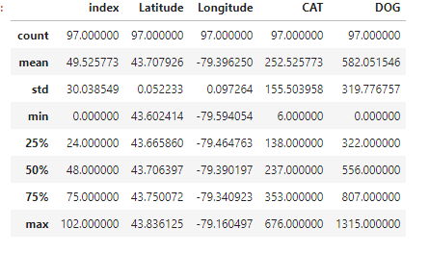
Understanding the data
Toronto neighbourhoods
Total : 87
Average Cats Average Dogs
252.525773 582.051546
Min / Max Cats Min / Max Dogs
0 / 676.000000 0 / 1315.000000
50 Quartile - 556
676.000000 | 1315.000000

Slide 8
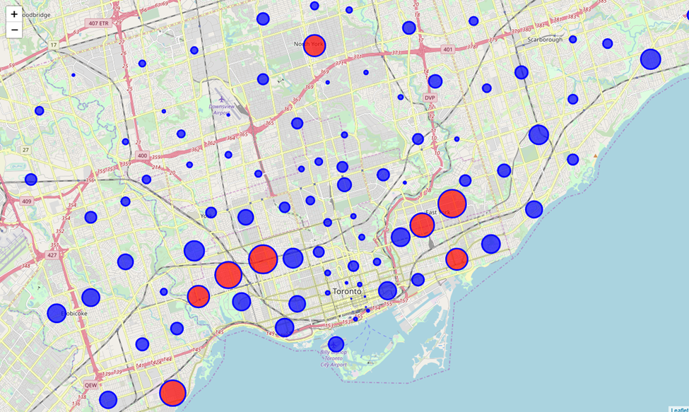
Visualization of cat data
EVALUATION
This bubble plot shows neighbourhoods with larger bubbles representing more animals

Slide 9
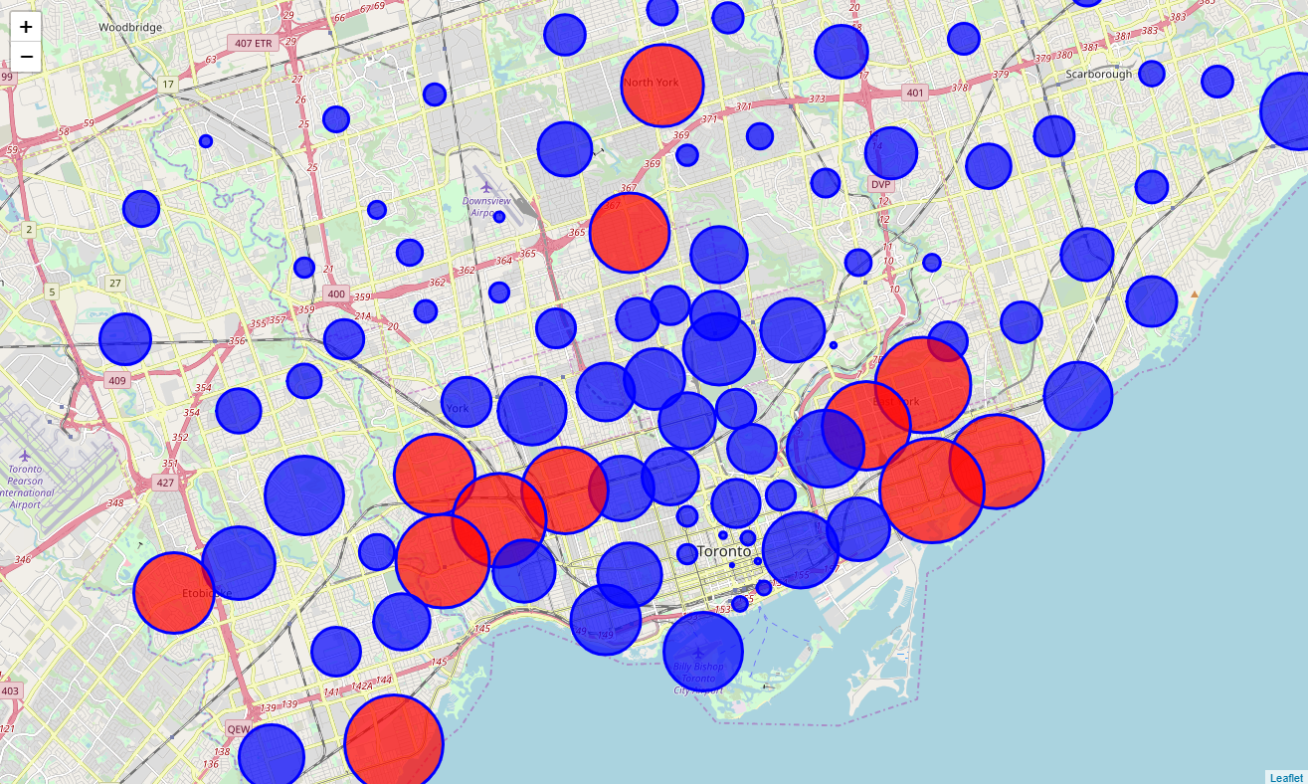


Visualization of dog data
EVALUATION
This bubble plot shows neighbourhoods with larger bubbles representing more animals

Slide 10
K Means Clustering
One of the algorithms that can be clustiner segmentation is K-means clustering.
it divides the data into k non-overlapping subsets or clusters without any cluster internal structure or labels.
This means, it's an unsupervised algorithm.
Objects within a cluster are very similar and objects across different clusters are very different or dissimilar.
This approach was applied to the combined data of the cat and dog populations to find the areas similarly highly populated by both dogs and cats.
And the results are:

Slide 11
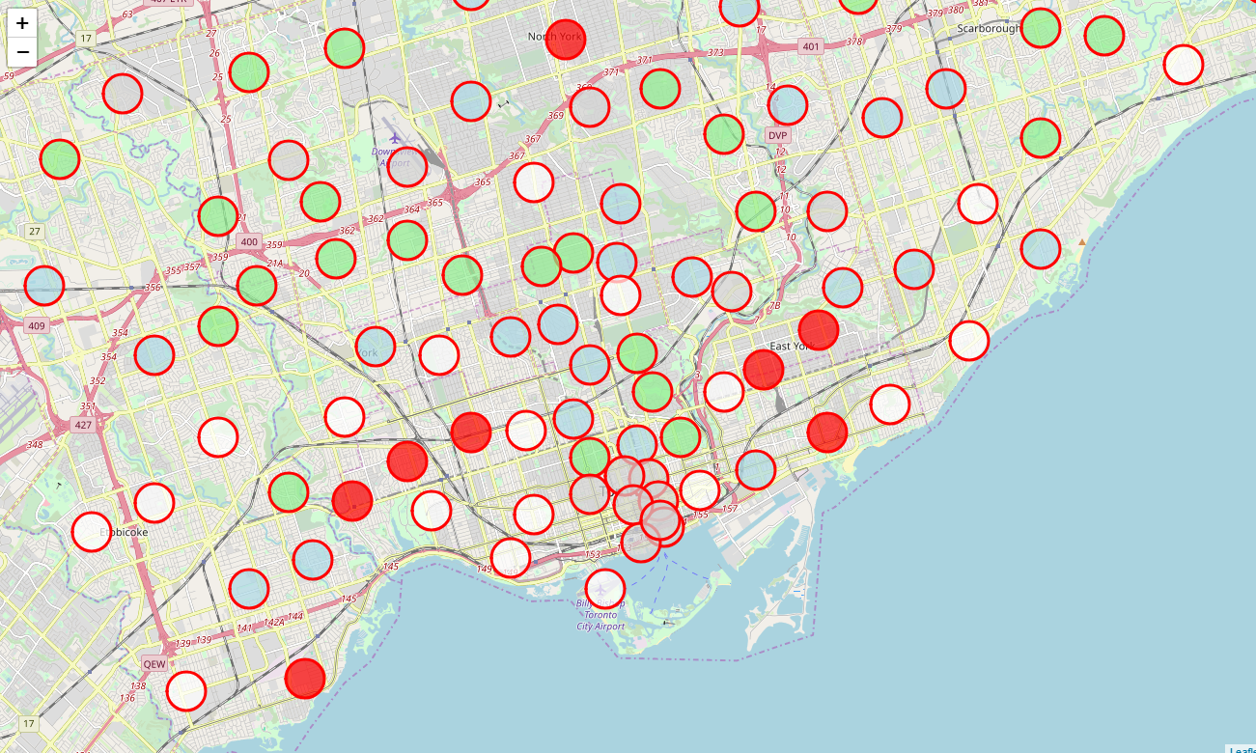
K means clustering of data
EVALUATION
RED NEIGHBOURHOODS ARE HIGHEST IN DOGS AND CATS.

Slide 12


Clustering 2 – neighbourshoods
+
=
doggystyle
Toronto
OUTCOME
Greenwhich Village NYC
Which are the most similar?
Use the foursquare API to find features and then cluster by similairty
Best neighbourhoods to move to.

Slide 13
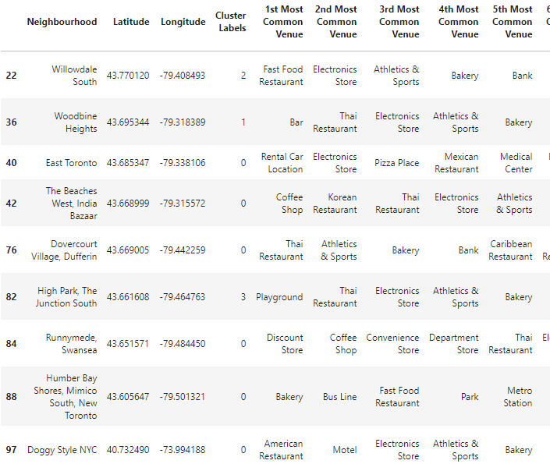
Clustering 2 – results

Slide 14
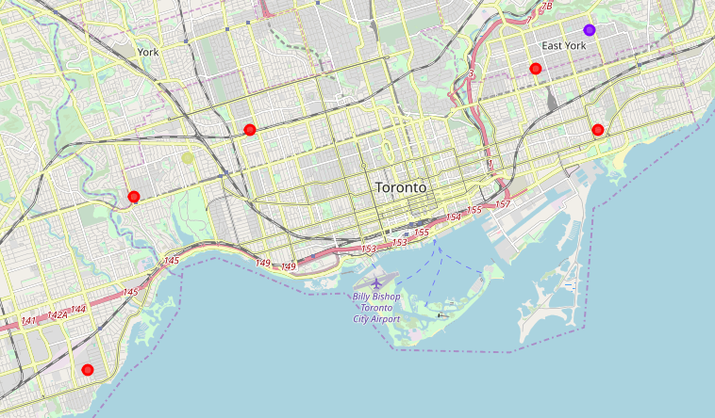
Clustering 2 – results

Slide 15

The winners are:
• East Toronto
• The Beaches West, India Bazaar
• Dovercourt Village, Dufferin
• Runnymede, Swansea
• Humber Bay Shores, Mimico South, New Toronto

Slide 16
discussion
Improved data needed
It got good results!
More data needed
This model and dataset could be futher improved by looking at the following data
- competition in the areas from other pet stores
- cost of rental in the areas selected by the model
to improve the viability of each location.
It is worth noting that differnt quantities for clusters and numbers of features were used but the model, but these numbers seem to produce the best results.
Furthermore, additional features in other datasets not explored by this report could help to further refine the models and produce better results.

Slide 17
Conclusion
According to the data and the machine learning models used to cluster the data, the 5 Best locations for the Doggy Style NYC expansion are:
- East Toronto
- The Beaches West, India Bazaar
- Dovercourt Village, Dufferin
- Runnymede, Swansea
- Humber Bay Shores, Mimico South, New Toronto

Slide 18
thank you
Ibm data science professional certificate

